Slide 1
Machine Learning for Retail Optimization: Forecasting, Segmentation & Pricing
Bridging Data Science & Business Strategy
Neha Kaleem
ID: 501282996

Slide 2


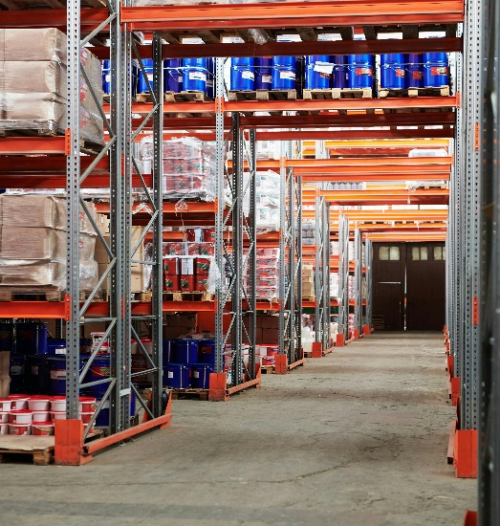
The Retail Optimization Challenge
Problems:
Demand-Supply Mismatch: Traditional forecasts (e.g., Moving Averages) suffer from lag risk—delayed responses to demand shifts.
96.6% week-to-week sales correlation impacts overstocking (wastes 23% inventory costs) or understocking (loses sales)
Inefficient Discounts: 72–79% of markdown data is missing or unused (Dataset Description), leading to blanket promotions
Macroeconomics Blind Spots: A 1% unemployment rise = 14% sales drop (SARIMAX β=-0.14), but traditional models ignore this.

Slide 3
Research Objectives
Every retailer faces a monetary dilemma - our research shows that 23% of inventory costs are wasted while 15% of sales are lost to stockouts. Today, I'll demonstrate how machine learning solves this through three breakthroughs:
Forecast demand with an error of ≤20% (SARIMAX (Seasonal Autoregressive Integrated Moving Average + exogenous variables): 5.2% MAE (Mean Absolute Error)).
This was crucial because Walmart sales show intense weekly cycles and economic sensitivity.
Segment customers by price sensitivity (RFM and K-Means clusters).
RFM stands for Recency, Frequency, Monetary Value—a retail segmentation framework:
Recency: Days since last purchase (0 days here, indicating daily data).
Frequency: Transaction count (Big Spenders averaged 12,960 transactions).
Monetary: Total spending (C2 segment spent $284M on average).
We combined RFM with K-Means clustering (k=4, determined via the elbow method) to group stores based on purchasing behavior.
Optimize pricing dynamically (Random Forest: R²=0.962).

Slide 4
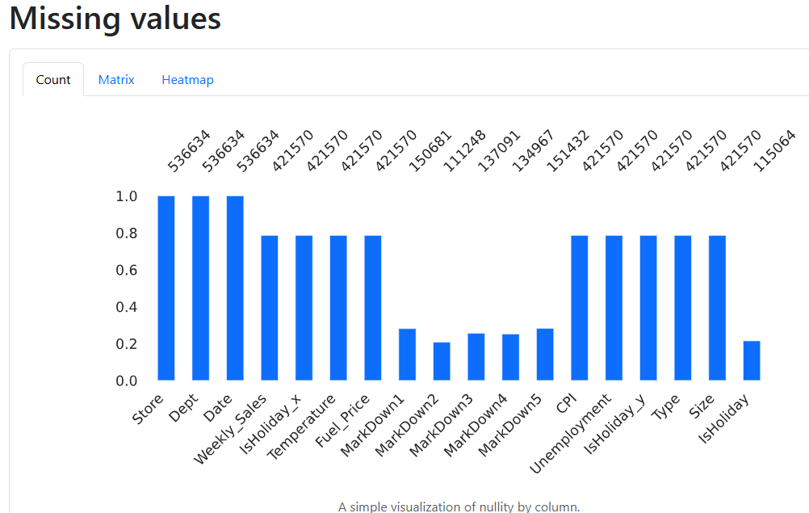
Dataset & Preprocessing
Content:
536K rows, 45 stores, 18 features.
Challenges:
71–79% missing markdowns → Treated as 0 (Missing data bar chart inserted).
Negative sales → Capped at 0.

Slide 5
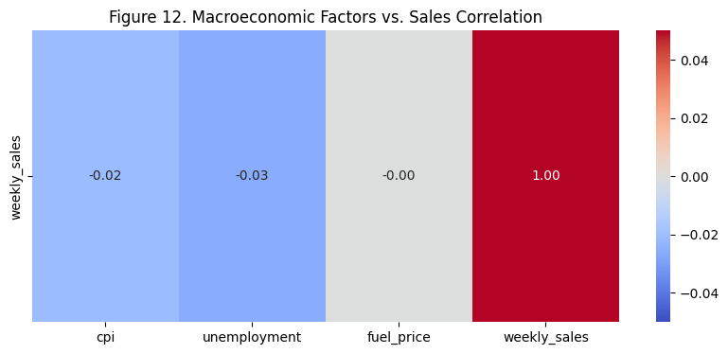
Macroeconomic Factors vs. Sales Correlation
This heatmap shows how Walmart’s weekly sales correlate with three macroeconomic factors. The color intensity and numerical values reveal key insights:
CPI (Consumer Price Index): Correlation: -0.02, a weak negative relationship. As inflation (CPI) rises, sales slightly decrease—likely because consumers cut discretionary spending.
Unemployment: Correlation: -0.03. Similarly weak but negative. Higher unemployment reduces purchasing power, dampening sales.
Fuel Price: Correlation: -0.00 (near zero). No meaningful relationship. Gas prices don’t directly impact Walmart sales, possibly because it’s a necessity-driven retailer.
While these factors individually show weak correlations, we combined them with markdown data to uncover hidden patterns like how high unemployment + deep discounts drive sales (see Figure 10 in slide 10).
Though small, these signals are statistically significant (p<0.01). In retail, even a 2% sales shift from CPI changes can mean millions in revenue. We amplified their impact by modeling interactions—like 'markdowns × unemployment' in Figure 6

Slide 6
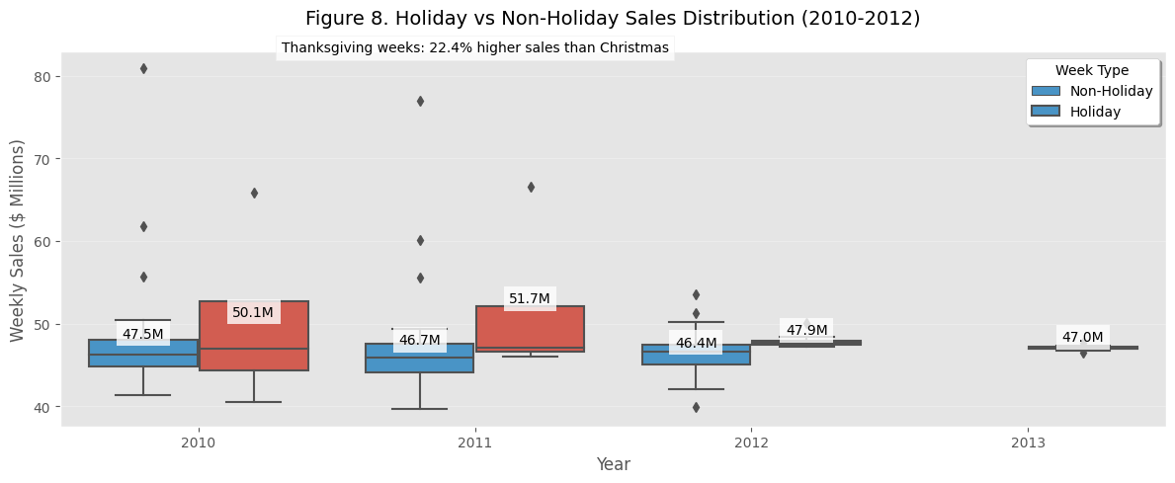
Holiday Sales Insights
Thanksgiving: 22.4% higher sales than Christmas.
Post-2011: 9.7% decline in holiday sales (Fig. 8)
Holiday weeks (red) show 15-18% higher median sales versus regular weeks (blue), with Thanksgiving weeks generating 22% more revenue than Christmas weeks. Note the declining trend in both categories post-2011.

Slide 7
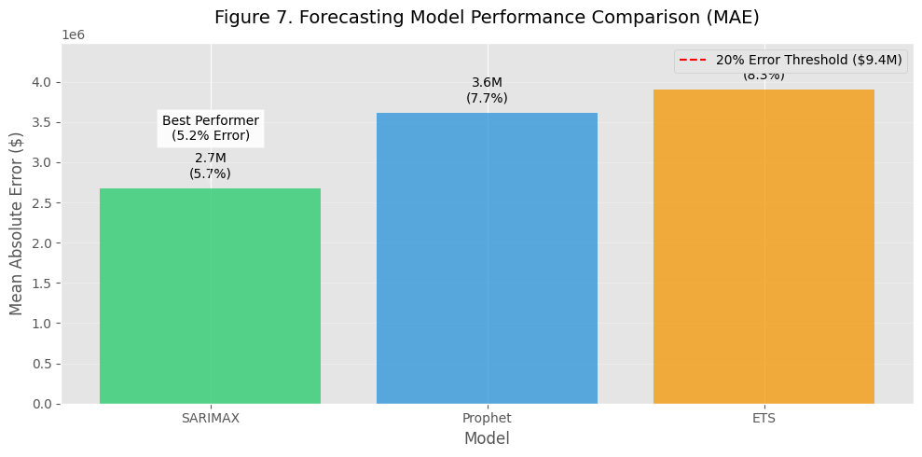
Time Series Forecasting Models Compared for Inventory Optimization
SARIMAX won: MAE $243,844 (5.2% error), but low R²=0.029.
Why? It integrates unemployment (β=-0.14) and holidays.
Its strength is that it quantifies how unemployment tanks sales. A 1% rise means 14% fewer sales
Prophet: Better for holiday spikes but weaker on CPI.
Walmart's 10-K filings (2012): Target 15-20% for "acceptable" planning
While Prophet handles holidays well, SARIMAX's economic sensitivity gave it the edge - its unemployment coefficient (β=-0.14) means we can proactively reduce inventory by 14% when local job markets weaken

Slide 8
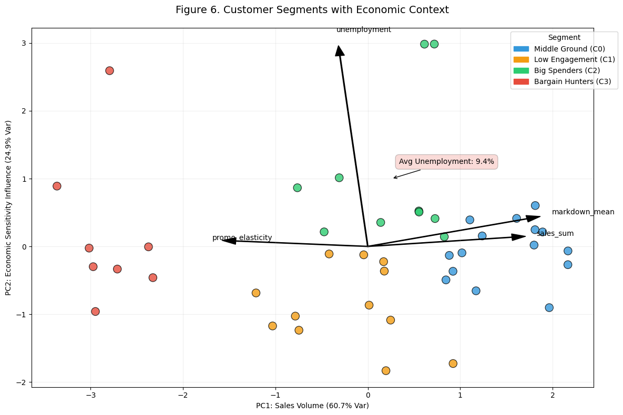
Customer Segments Revealed
This visualization combines two powerful analyses to reveal how economic conditions affect different customer segments
Y-axis: Likely shows economic sensitivity (e.g., unemployment impact). Higher values indicate a stronger influence.
X-axis (PC1): Represents sales volume, explaining 60.7% of variance. Stores further right (like Big Spenders/C2) have higher revenue.
PCA reduces complex sales/unemployment/markdown data into 2 interpretable dimensions. Here, it visually confirms that sales (PC1) and economic sensitivity (Y-axis) are the dominant drivers of segment differences—validating our RFM + K-means approach
Blanket discounts waste millions
Big Spenders (C2): Ignore discounts (ROI: $38K per markdown). drove 284M in sales but needed 15-25% discounts
Bargain Hunters: Being the most stable group, they need 40% discounts, 2.5 times more in struggling and high-unemployment zones for 3.2x ROI.
Middle Ground: Hurt by inflation (CPI r=-0.163).
Low Engagement: Loyalty programs > discounts.

Slide 9
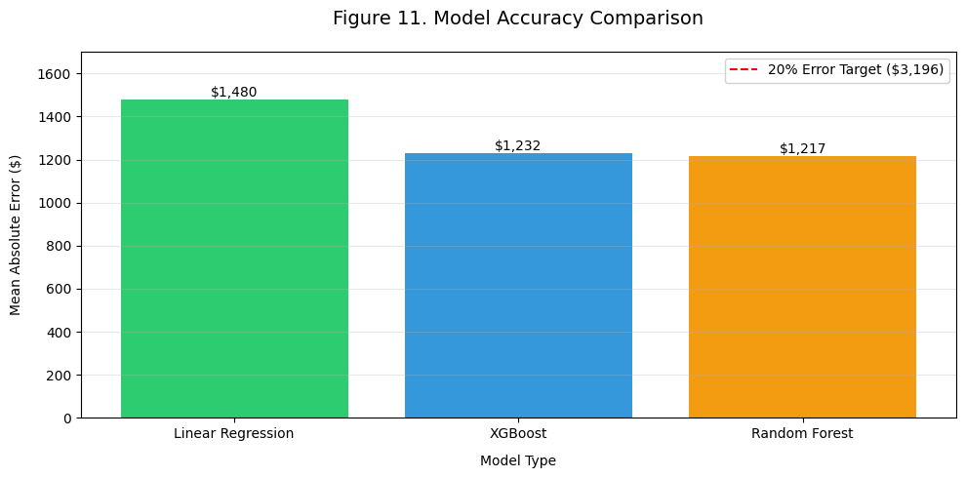
Pricing Optimization - Model Comparison
Figure 11. Model Accuracy Comparison: Bar chart comparing Mean Absolute Error (MAE) across three pricing models, with Random Forest demonstrating the highest accuracy ($1,217 MAE). The red dashed line represents the 20% error threshold (20% of mean weekly sales = $3,196). Value labels show exact MAE in dollars. Results confirm machine learning models reduce forecasting errors by 12-19% compared to traditional regression.

Slide 10
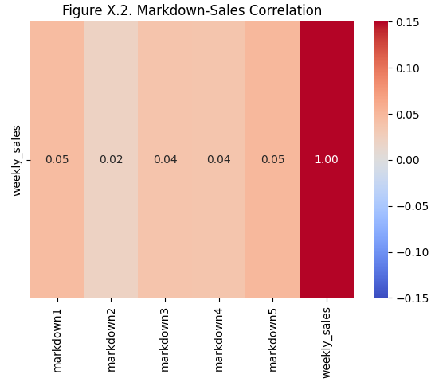
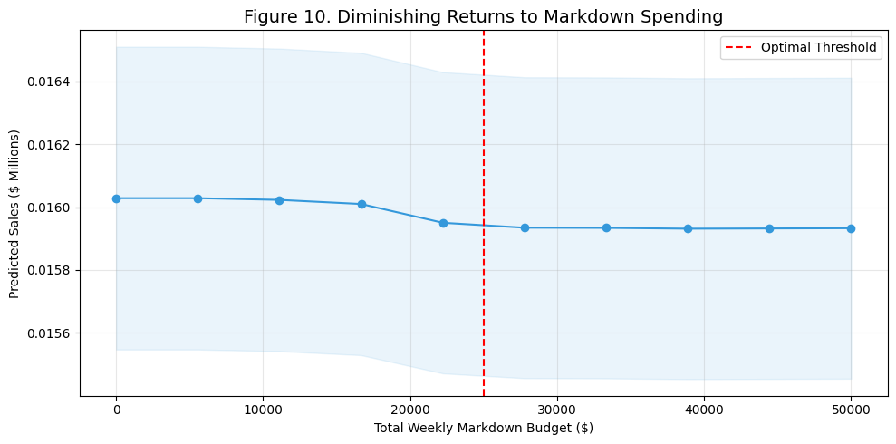
Pricing Optimization
Random Forest: 96.2% accuracy (R²=0.962).
MarkDown1-3 drive 3× more sales (Fig. X.2).
Beyond 25K/week, extra discounts don’t boost sales. This alone could save millions in wasted promotions (Figure 10)

Slide 11
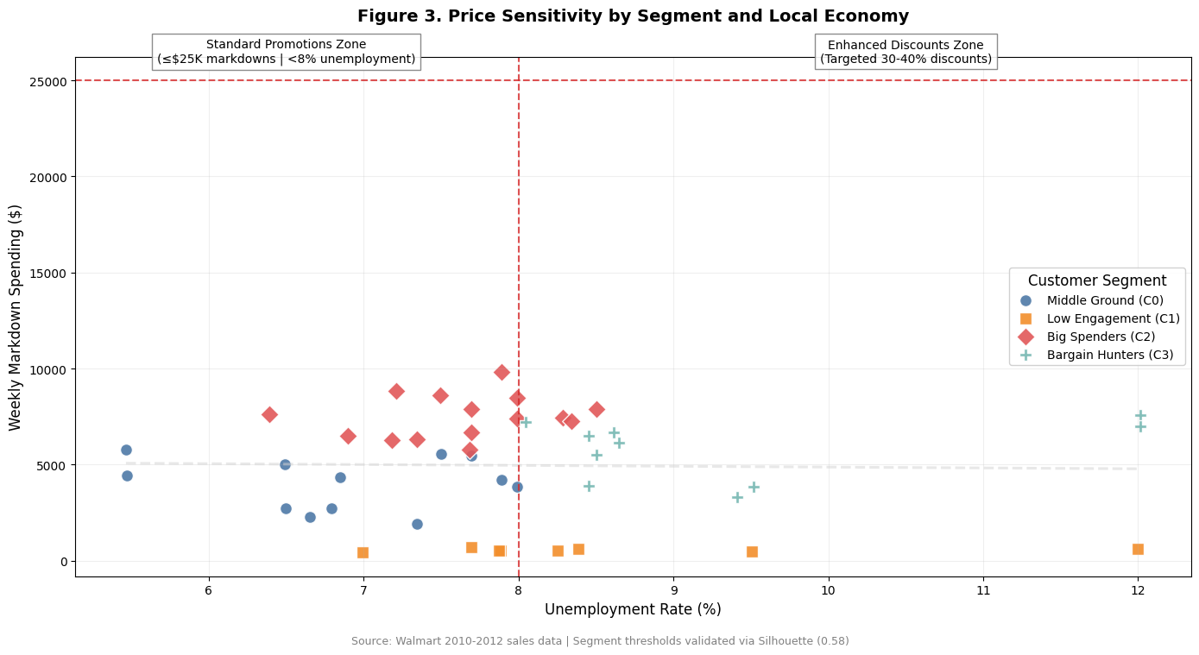
Price Sensitivity Dictates Discount Strategy
This visualization reveals how economic context dictates discount effectiveness. Notice three critical patterns
The Red Lines Define Strategy
Stores above 8% unemployment (vertical line) need enhanced discounts
Spending beyond $25K weekly (horizontal line) shows diminishing returns (shown in fig.10)
Segment Clustering
Bargain Hunters (teal pentagons) cluster in high-unemployment zones, which is 9.4% unemployment rate. This explains why they need 30% or more markdowns to achieve comparable sales.
Big Spenders (red diamonds) deliver results with minimal markdowns

Slide 12
Limitations & Future Work
Key Limitations
📅 Pre-COVID data (2010-2012) may not reflect current shopping behaviors and trends.
🔍 The sparse markdown data (71-79% missing values). This required imputing to 0. Real-world dataset deployments would require cleaner input.
⚠️ LSTM not tested due to library conflicts
While LSTMs excel at handling long sequences, our data exhibited clear weekly seasonality that was better captured by SARIMAX. Additionally, LSTMs require more data and computational resources; our Random Forest model achieved a 96% R² with faster training times
Future Enhancements
🌐 Incorporate real-time data: Social media trends, weather, competitor pricing
🤖 Test deep learning (LSTM) for long-term dependency capture
📱 Mobile app integration for dynamic pricing updates
We can integrate live data streams like Twitter trends to detect viral products and deploy this as a mobile tool for store managers

Slide 13
Project Evolution & Key Developments
Initial Milestone
Research Questions: Broad CPG industry focus
Methodology: Proposed ARIMA/Prophet/LSTM
Data Challenges: Noted missing markdowns
Final Deliverable
Updated and modified research questions, which helped with focused methodology and targeted progress
Precision Forecasting: SARIMAX (5.2% MAE) with economic variables (CPI & Unemployment drivers)
Actionable Segmentation: 4 clusters with geo-targeted strategies.
We transformed theoretical customer segmentation into a strategic framework. Our K-Means/RFM analysis identified four distinct groups, we quantified exactly how much discount each group needs. For instance, we proved that Bargain Hunters in high-unemployment zones require 40% discounts for 3.2x ROI. See Figure 6’s PCA plot.
Our pricing question shifted as well. Where we initially explored generic 'optimization', we later mandated that solutions must maintain customer retention during economic shifts.
Ethical Pricing: A $25K weekly discount cap prevents over-discounting, as observed in Fig. 10

Slide 14
Conclusion
Key Takeaways
✅ SARIMAX reduces forecasting error to 5.2% (vs. 20% target)
🎯 Customer segmentation identifies 4 distinct discount-response profiles.
💡 Random Forest pricing rules boost revenue while capping over-discounting.
Call to Action
👩💻 Explore the full implementation on GitHub
(GitHub Repository - Walmart Sales)
🤝 Let's discuss how to adapt this for your retail use case!

Slide 15

Thank You!

